Slide 1
Introduction to Large Language Models (LLMs)
What are Large Language Models?
Large Language Models (LLMs) are advanced artificial intelligence models designed to understand, process, and generate human-like natural language. They are trained on very large text datasets using deep neural networks, mainly based on the Transformer architecture.
LLMs learn:
Grammar and sentence structure
Meaning and context of words
Relationships between concepts
Reasoning patterns in text
Because of this, LLMs can perform many language tasks without being explicitly programmed for each task.

Slide 2
Examples of LLMs
GPT series (GPT-3, GPT-4) – text generation and conversation
(Generative Pre-trained Transformer)
BERT – text understanding
(Bidirectional Encoder Representations from Transformers)
T5 – text-to-text tasks
(Text-To-Text Transfer Transformer)
LLaMA – open-source foundation model
(Large Language Model Assistant)

Slide 3
Generative AI
Definition
Generative AI refers to AI systems that can generate new content such as text, images, audio, video, or code instead of only analyzing or classifying existing data.
Key Characteristics
Produces original outputs
Learns patterns from large datasets
Can adapt to different creative and technical tasks

Slide 4
Examples of Generative AI
ChatGPT generating essays
DALL·E generating images from text
Music generation tools
Code generation tools

Slide 5
Difference Between Traditional AI and Generative AI
Aspect | Traditional AI | Generative AI
Definition | Analyzes data and makes predictions based on rules or learned patterns. | Generates new content such as text, images, audio, or code.
Purpose | Analyze & Predict | Create & Generate
Output | Decisions, classifications, recommendations | Text, images, music, code, videos
Learning Type | Supervised or rule-based learning | Unsupervised or self-supervised learning
Examples | Fraud detection, loan approval, face recognition, stock prediction | ChatGPT, DALL·E, AI music composition, code generation
Applications | Medical diagnosis, autonomous systems, recommendation engines | Content creation, chatbots, creative design, text/image generation
Creativity | Low | High

Slide 6
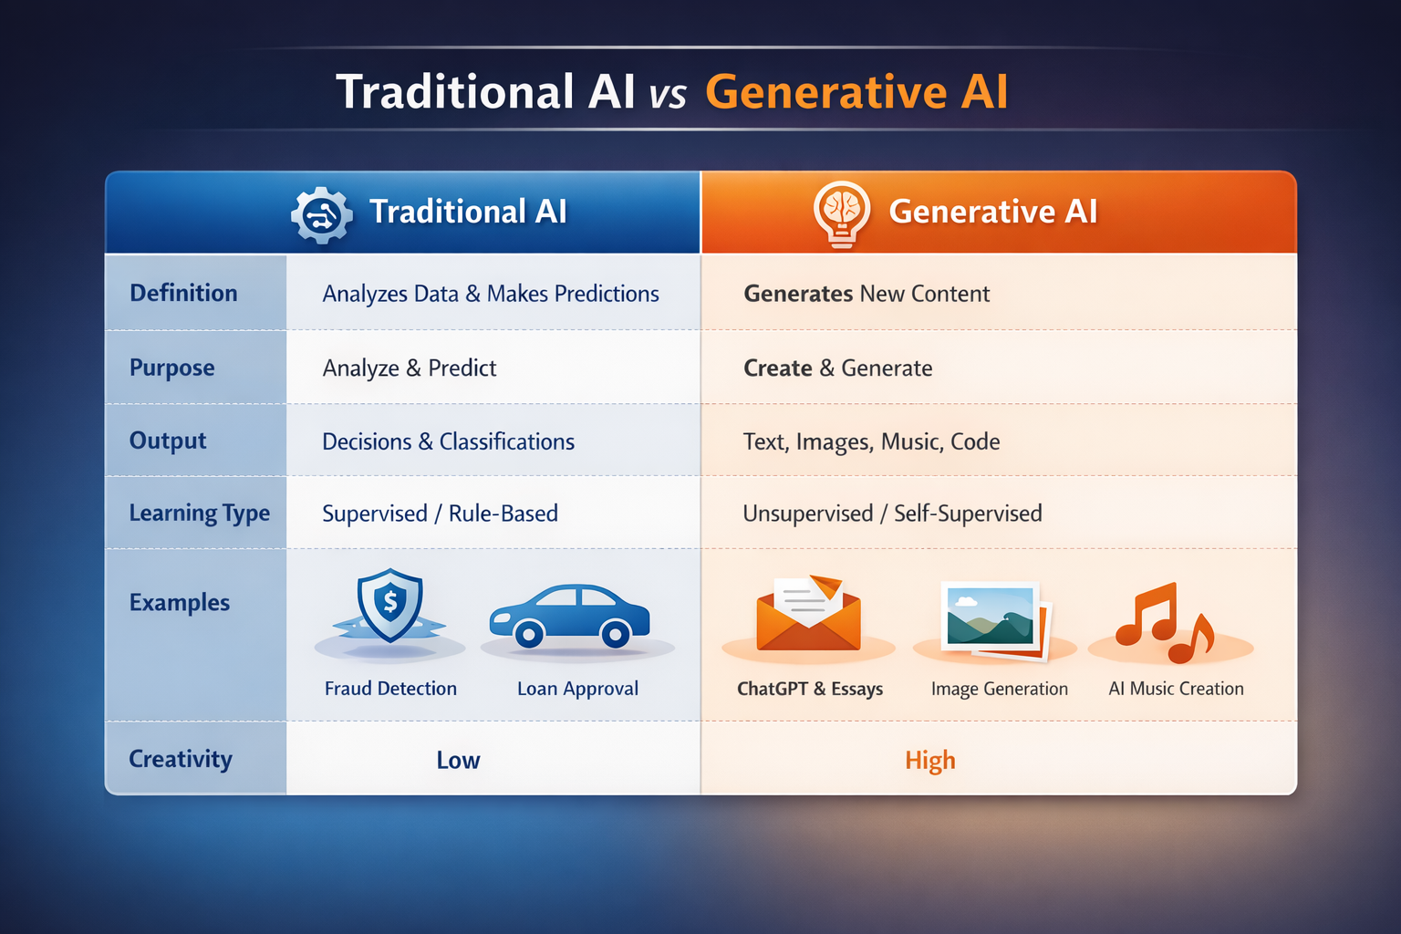

Slide 7
Foundation Models
Foundation models are large pre-trained models trained on diverse massive datasets and adaptable to multiple tasks through fine-tuning.
Foundation models are very large AI models that act as a base (foundation) for many applications.
They are not built for just one task; instead, they are general-purpose models.
Trained on diverse massive datasets
The training data comes from many different sources:
Books
Websites
Articles
Code repositories
Because the data is diverse, the model gains broad knowledge across many topics.

Slide 8
Why Are They Called “Foundation” Models?
They act as a base or foundation upon which many task-specific models can be built using fine-tuning.
Key Features
Trained once, reused many times
Multi-task capability
Transfer learning enabled
Example
A single BERT model can be fine-tuned for:
Sentiment analysis
Named entity recognition
Question answering
Spam detection

Slide 9
Architecture of Large Language Models
LLMs are based on the Transformer architecture, which relies on attention mechanisms instead of recurrence or convolution.
Attention Mechanisms
Attention is the key feature of Transformers.
It allows the model to focus on important words in a sentence when generating or understanding text.
Example: In the sentence “The cat that chased the mouse was hungry.” When predicting “was hungry,” the model pays more attention to “cat” than to “mouse” because “cat” is the subject.

Slide 10
Architecture of Large Language Models Continued…
Encoder Architecture
Decoder Architecture
Encoder–Decoder Architecture

Slide 11
Encoder Architecture
Purpose of Encoder Models
Encoder models are designed to understand the meaning of text.
They focus on comprehending context, not generating new text.
Example: BERT is an encoder model. It can answer questions or classify text because it deeply understands the input.

Slide 12
How an Encoder Works
1. Input text is converted into tokens
Text is split into smaller units (words, subwords, or characters).
Example: "The cat sleeps“ -> ["The", "cat", "sleep", "s"]
2. Tokens are embedded into vectors
Each token is represented as a numeric vector that the model can process.
These vectors capture semantic meaning, e.g., “cat” and “dog” vectors are closer than “cat” and “car”.

Slide 13
How an Encoder Works Continued…
3. Self-attention captures relationships between all words.
The attention mechanism lets the model see how every word relates to every other word.
Example: In "The cat chased the mouse”, the model knows that "cat” is the one doing the action, not "mouse“.
4. Output is a contextual representation
After processing, each token now has a context-aware vector.
These vectors contain information about meaning and relationships in the sentence.
They can be used for tasks like text classification, sentiment analysis, or question answering.

Slide 14
Decoder Architecture
Purpose of Decoder Models
Decoder models are mainly used for text generation.
Their goal is to produce new text one word at a time, bas
Examples: GPT series (GPT-2, GPT-3, GPT-4).ed on what has already been generated.

Slide 15
How a Decoder Works
1. Takes previously generated words as input
The decoder starts with a prompt or starting words.
Each new word it generates is fed back as input for the next prediction.
Example:
Input: “Artificial intelligence”
Model predicts → “is” Next input: “Artificial intelligence is”

Slide 16
How a Decoder Works Continued..
2. Uses masked self-attention so future words are hidden
The decoder uses a special type of attention called masked self-attention.
This mask prevents the model from seeing future words while predicting the current word.
This keeps the generation process realistic and sequential, just like humans write.

Slide 17
How a Decoder Works Continued..
3. Predicts the next word step-by-step
The model predicts one token at a time.
After predicting a word, it moves to the next step and predicts again.
This continues until the sentence or paragraph is complete.

Slide 18
Encoder–Decoder Architecture
Purpose of Encoder–Decoder Models
Encoder–Decoder models are used for sequence-to-sequence (Seq2Seq) tasks.
In these tasks, both input and output are text, but they may be different in length or language.
Common applications:
Machine Translation (English → Hindi)
Text Summarization
Question Answering
Text Paraphrasing

Slide 19
Example
Input: “How are you?”
Output: “आप कैसे हैं?”
Models Using Encoder–Decoder Architecture
T5
BART
Transformer (original)
Applications
Machine translation
Text summarization
Question answering

Slide 20
How Encoder–Decoder Works
1. Encoder processes input sentence
The encoder reads and understands the entire input sentence.
It converts the input text into contextual representations using embeddings and self-attention.
Output: a set of context-rich vectors that capture the meaning of the input.

Slide 21
How Encoder–Decoder Works Continued..
2. Decoder generates output sentence using encoder context
The decoder starts generating the output word by word.
It uses:
Previously generated words
Information received from the encoder
This allows the decoder to produce text that is relevant to the input.

Slide 22
How Encoder–Decoder Works Continued..
3. Cross-attention connects encoder and decoder
Cross-attention allows the decoder to focus on important parts of the input sentence while generating each output word.
Example (Translation): Input: “I am learning AI” Output: “मैं AI सीख रहा हूँ” While generating “सीख”, the decoder attends strongly to “learning”.

Slide 23
Pre-Training Concept
Definition
Pre-training is the first and most important training stage of a large language model.
In this phase, the model learns general language knowledge such as:
Grammar
Vocabulary
Sentence structure
Common facts and patterns
Nature of Pre-Training
Self-supervised learning
No human labeling required
Uses objectives like next-word prediction

Slide 24
1. Self-supervised learning
The model creates its own training labels from raw text.
No manual annotation is needed.
Example: Input: “Deep learning is a branch of ___” Target word: “Artificial Intelligence”

Slide 25
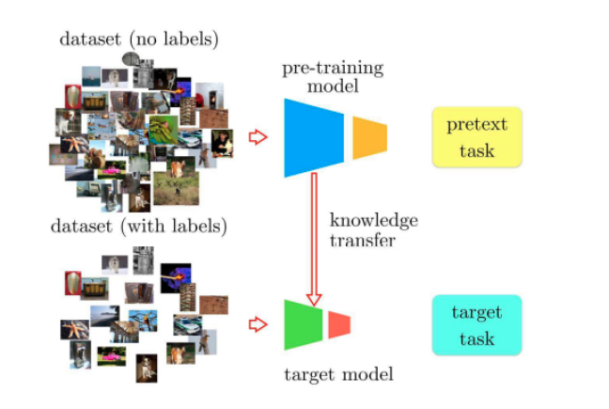

Slide 26
2. No human labeling required
Since labels are automatically generated from the text itself, humans do not need to tag or label data
This allows training on massive datasets with billions of words.

Slide 27
3. Uses objectives like next-word prediction
The most common objective is next-token (next-word) prediction.
The model learns by predicting the next word based on previous words.
Example: Input: “Transformers are very” Model predicts: “powerful”

Slide 28
Example
GPT learns to predict the next word in a sentence:
“Machine learning is a branch of ___”
Advantages
Learns grammar and context
Captures world knowledge
Reduces need for large labeled data later

Slide 29
Fine-Tuning Concept
Definition
Fine-tuning is the process of adapting a pre-trained model to a specific task or domain using a smaller dataset.
Example
Pre-trained GPT → Fine-tuned for legal document analysis
Pre-trained BERT → Fine-tuned for exam answer evaluation

Slide 30
Pre-trained GPT → Fine-tuned for legal document analysis
What it means
GPT is originally pre-trained on general text (books, articles, websites).
It knows grammar, sentence structure, and general reasoning.
Through fine-tuning, GPT is adapted to understand legal language and tasks.

Slide 31
What happens during fine-tuning
The model is trained on:
Legal contracts
Court judgments
Case summaries
Legal Q&A datasets
It learns:
Legal terminology (e.g., plaintiff, affidavit, jurisdiction)
Formal legal writing style
How to analyze clauses and obligations

Slide 32
Result
GPT can now:
Summarize legal documents
Extract key clauses
Answer legal questions
Assist lawyers in document review

Slide 33
Pre-trained BERT → Fine-tuned for Exam Answer Evaluation
What it means
BERT is an encoder-based model trained to understand text meaning.
It does not generate long text but is excellent at comparison and analysis.
Fine-tuning adapts BERT to evaluate student answers.

Slide 34
What happens during fine-tuning
The model is trained on:
Question–answer pairs
Model answers
Student responses with marks or labels
It learns:
Semantic similarity between answers
Key concept matching
Partial correctness

Slide 35
Benefits
Higher task accuracy
Less data required
Faster training

Slide 36
Challenges in LLM Training
1. Data Challenges
Issues
Poor data quality
Duplicate content
Lack of domain data
Biased data
Impact
Incorrect outputs
Hallucinations
Ethical concerns

Slide 37
2 Compute Challenges
Issues
Requires high-end GPUs/TPUs
Long training time
High electricity consumption
Example
Training large models may cost millions of dollars.

Slide 38
3 Bias and Ethical Challenges
Sources of Bias
Social bias in training data
Cultural imbalance
Gender stereotypes
Risks
Discriminatory outputs
Misinformation
Loss of trust

Slide 39
4 Efficiency Challenges
Problems
Large model size
Slow inference
High memory usage
Solutions
Model compression
Quantization
Knowledge distillation

Slide 40
Conclusion
Large Language Models are the backbone of modern Generative AI systems. Understanding their architecture, training methods, and challenges is essential for building responsible, efficient, and accurate AI systems.

